Slide 1
Virginia Longitudinal Data System (VLDS)
November 11, 2014

Slide 2
Background
Funded by USED through 2009 ARRA Grant
Design/development 2010-2013
Live - September 2, 2013
Establishes an integrated system for the sharing and analysis of data across executive branch agencies
Consistent with federal and state statutes and regulations
Video

Slide 3
Partners / Data Providers
Department of Education
State Council on Higher Education
Virginia Employment Commission
Virginia Community College System
Department of Social Services Department of Aging and Rehabilitative Services (in process)
Department of Labor and Industry (2015?)
VLDS is extensible to allow for additional
Partners to share and merge their data.

Slide 5
The Burning Questions
How can Virginia improve high school graduation rates while increasing students' preparation for college and careers?
How can Virginia improve the preparation, recruitment, and retention of Virginia's educational personnel, including their meaningful and ongoing professional development, especially in teacher shortage areas and in hard-to-staff schools?
How can Virginia improve performance of the public workforce system?
By what means can Virginia's public workforce development system meet the needs of job seekers/workers and employers?

Slide 6
DSS Burning Questions
How does participation in public assistance programs (e.g. child care, WIC, Head Start, SNAP, TANF, Medicaid) in Virginia impact school readiness, school achievement, health, family cohesion, future employment, and wages?
What is the return on investment from public assistance programs in Virginia? Are there patterns that suggest different program delivery models that may yield greater effectiveness or cost savings?
What are the most critical health, safety, and community factors that contribute to children’s school readiness and school achievement?
What factors in the life of a foster care child have the greatest impact on school achievement and later mental, physical, and financial health?
How does investment in early childhood health and education impact future need for and cost of public assistance?
How many child care providers who participate in Virginia’s Child Care Provider Scholarship Program go on to obtain an associate or bachelor’s degree in early childhood?
What factors contribute to the success of TANF (Temporary Assistance for Needy Families) recipients after leaving the program. In particular, are those participating in TANF work skills training programs employed and earning a living wage one or two years after completing the program? Which work skills programs have the greatest success rates?

Slide 7
VDOE/SCHEV Data Insights
Persistence and college graduation is linked to high school achievement
CTE completers who earned Advanced Studies diplomas had the highest average wages three-months after graduating with a Bachelor’s degree
We can predict students at risk of not being successful in school

Slide 8
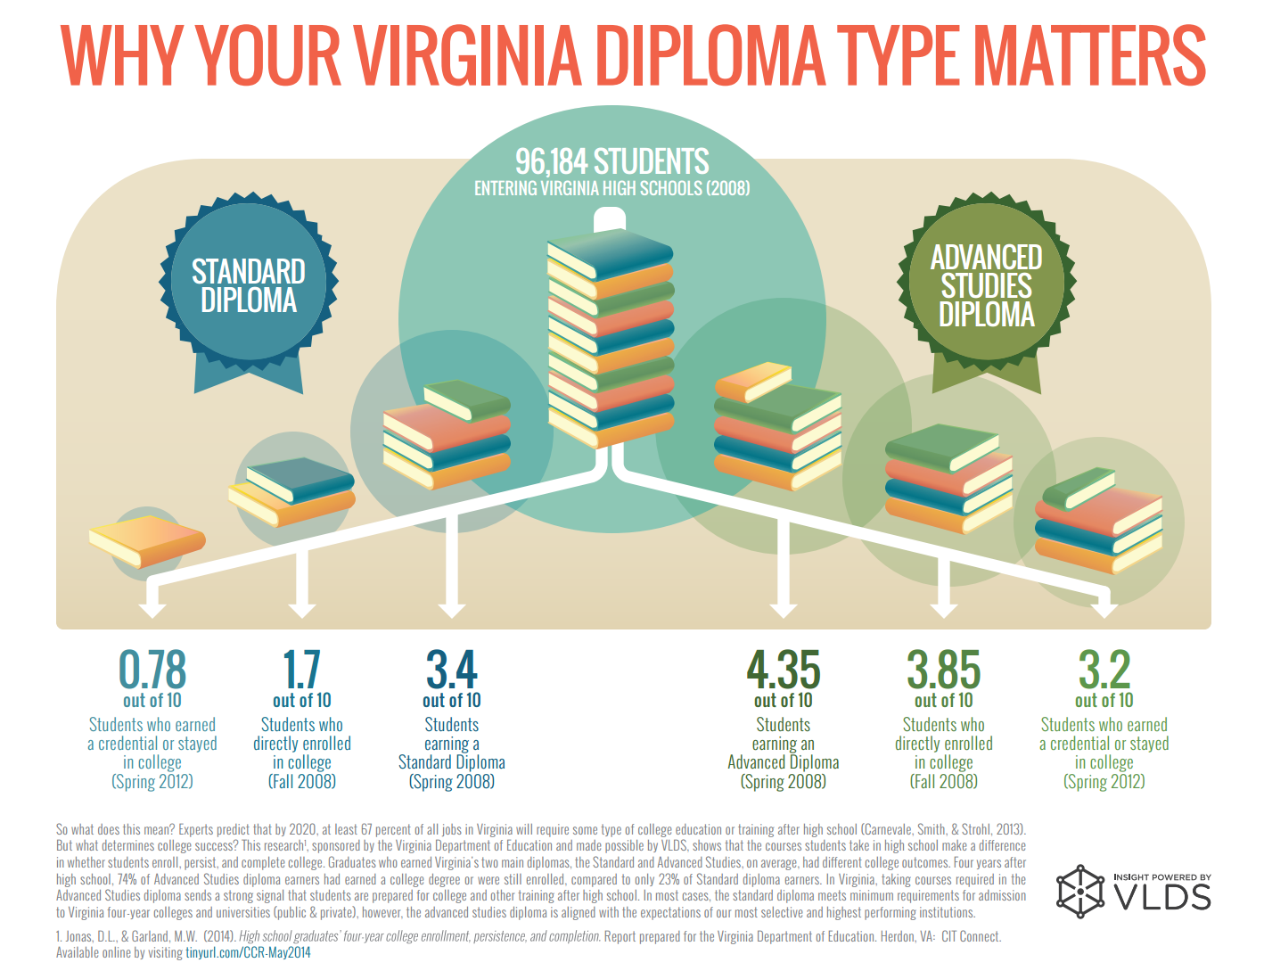

Slide 9
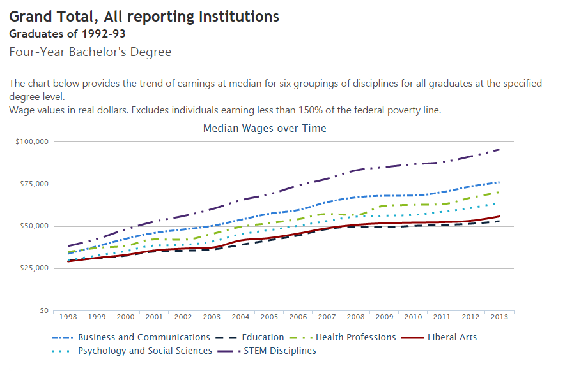
Mid-Career Wage Outcomes

Slide 10
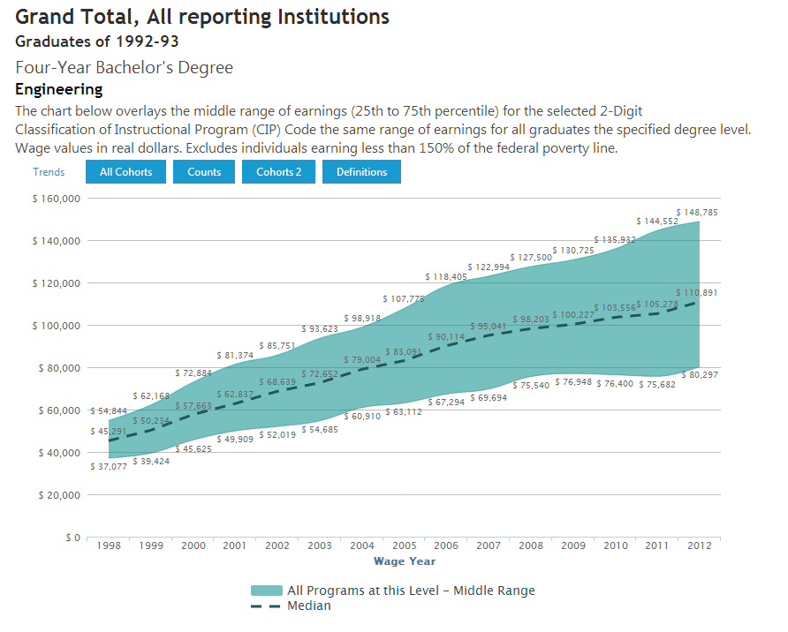
Mid-Career Wage Outcomes

Slide 11
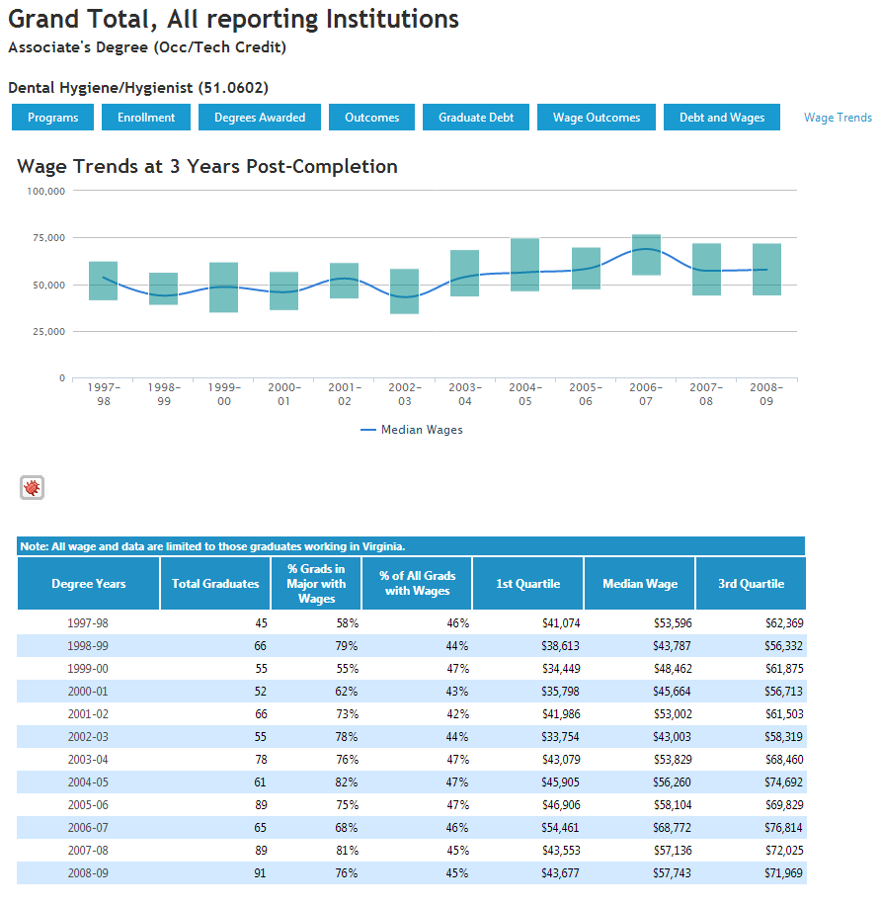
State-Level Program Scorecard
(September 2014)

Slide 12
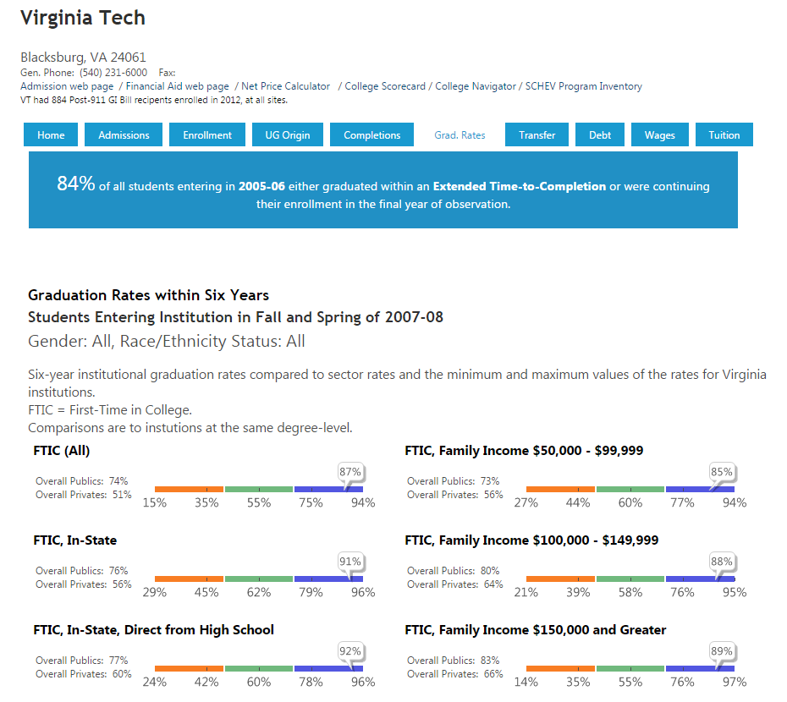
Institution Profiles

Slide 13
Closing Comments
VLDS is a powerful tool for linking data and studying outcomes over time.
SCHEV has over 20 years of student-level data to inform policy.
No other state publishes the detail, nor provides the flexibility in use, that SCHEV does.

